Slide 1

NEEDFINDING
Neil Iverson Sarte / Carl James Rosalita

Slide 2

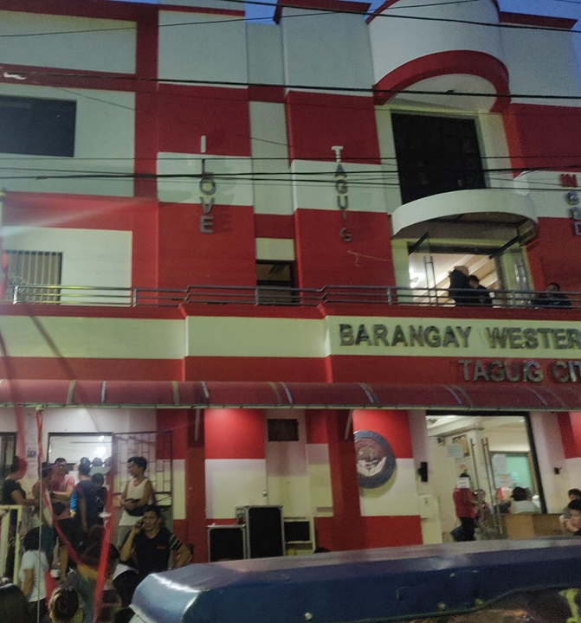
What Activity did you choose to examine?
We chose to examine the process of getting documents from the Barangay, like Barangay Clearance, Business Permit, Construction Clearance etc.
We went to our respective Barangays (Western Bicutan, Pinagsama) to see and observe their process of issuing Barangay documents

Slide 3
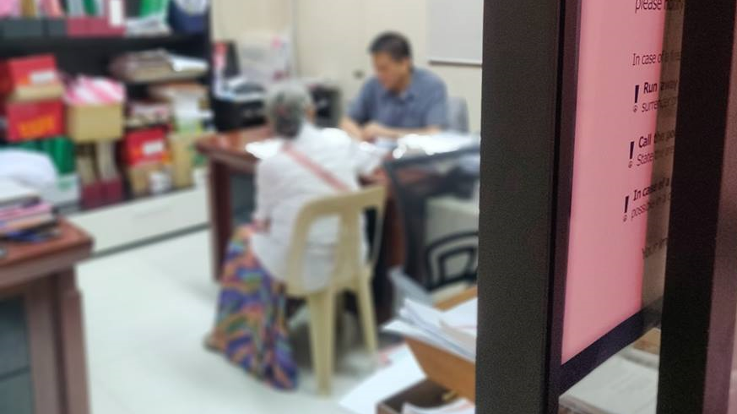
How do you Examine it, with what Methods?
In order to fulfill the activity, we went to our respective Barangays (Western Bicutan, Pinagsama) to see and observe their process of issuing Barangay documents.
We also conducted informal interviews to numerous Barangay Officials and also some of the residents whose requested certain documents.
We also observe what is happening on the lobby, where the residents are requesting the documents.

Slide 4
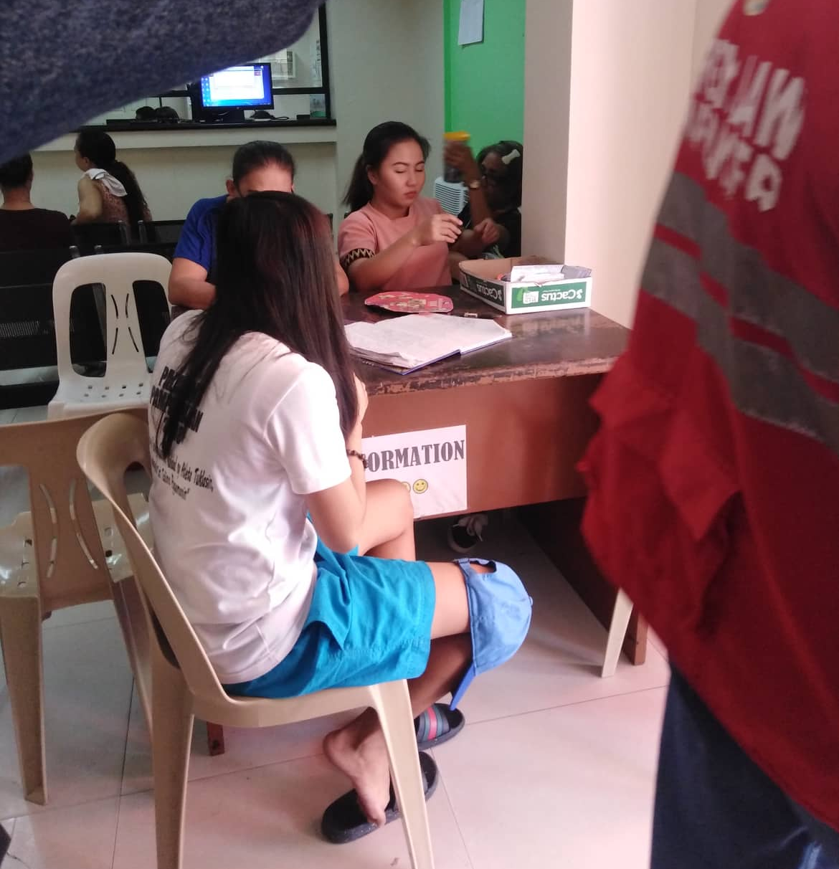
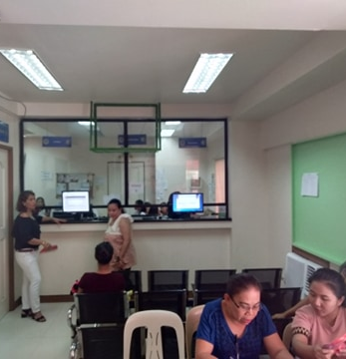
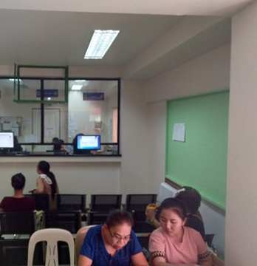

Slide 5
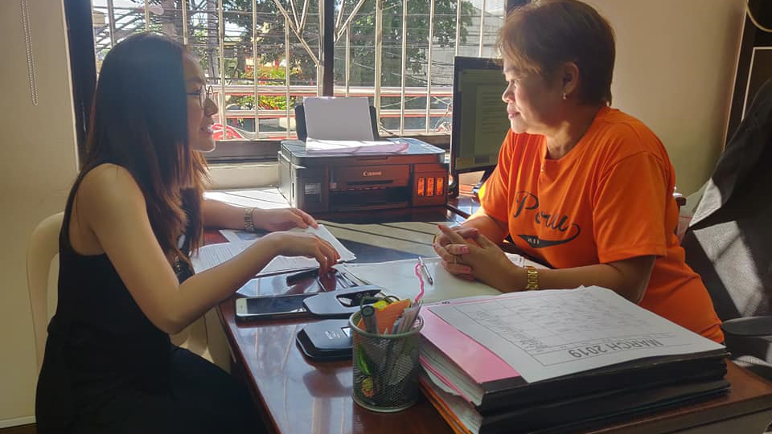
What major insights or breakdowns did you discover?
We interview one of the barangay officials about the current flow about requesting and issuing documents.
There are about 10 to 12 people are going to the Barangay Hall everyday to request documents to them, mostly Barangay Clearance.
The Barangay usually requires an authorization letter in order for the residents to request a document
The authorization letter mainly issued by the Barangay Officials that has the power to issue such one, most notably the Barangay Councilors and the Barangay Captain.
The authorization letter serves also as the proof that an individual is a resident of the Barangay.
Those officials usually are not around the Barangay Hall for most of the time, usually during office hours.
The residents now tends to find atleast one official to issue them an authorization letter.

Slide 6
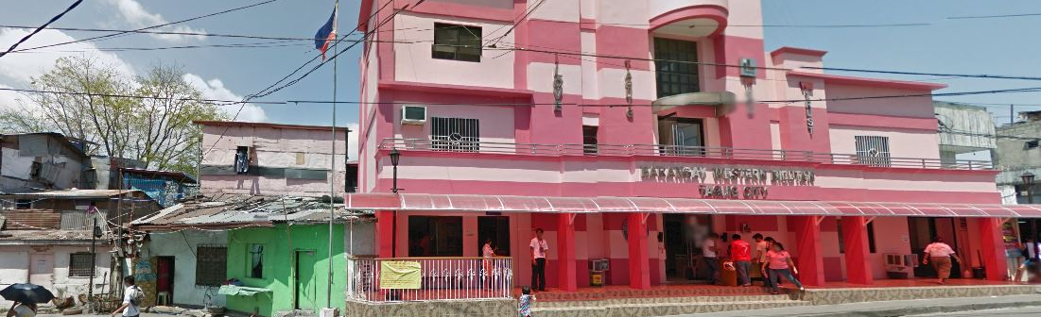
What promising unmet needs were identified as a result?
The Barangay needs to have a way where they can verify every individual if he or she is a bonafide resident of the Barangay, especially to those that are requesting documents to them, like Barangay Clearance, Business Letter etc.
The Barangay needs to have an alternative to the authorization letter, since the letter serves as a proof that the individual is a resident of the barangay. And also to eliminate the time that is consumed by just finding a proper Brgy. Official to issue them a letter.

Slide 7
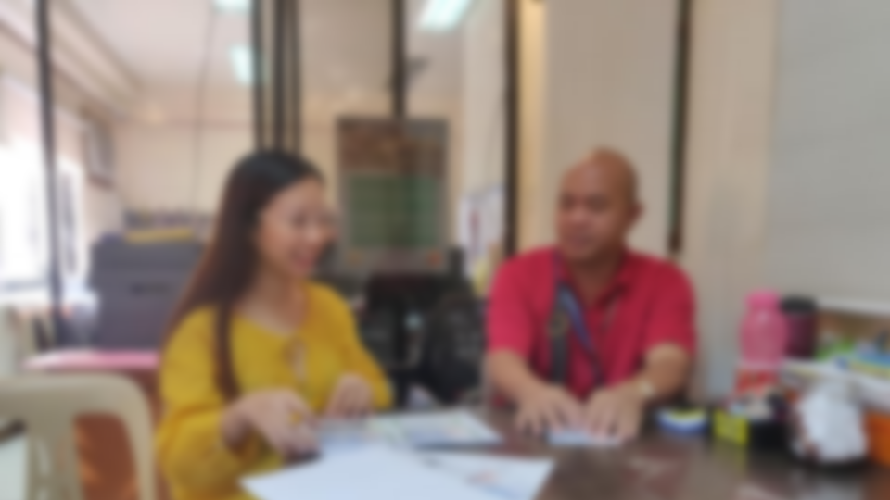
User Point Of View
Why would I physically find an official to authorize my request, when I could request online and let an official authorize it there. (Citizen)
I could go directly to the hall to request a document, but it will take me a couple of minutes, especially when they verify my data there. (Citizen)
Conducting a short and brief interview to persons requesting a document to verify their data will consume a couple of minutes, and it will be inconvenient to them. (Brgy. Clerk)
Being an official is only a part time job, how can i authorize someone requesting a document when I am not always around? (Brgy. Official)

Slide 8
Storyboard

Slide 9
Paper Prototype

Slide 10
Testing Process

Slide 11
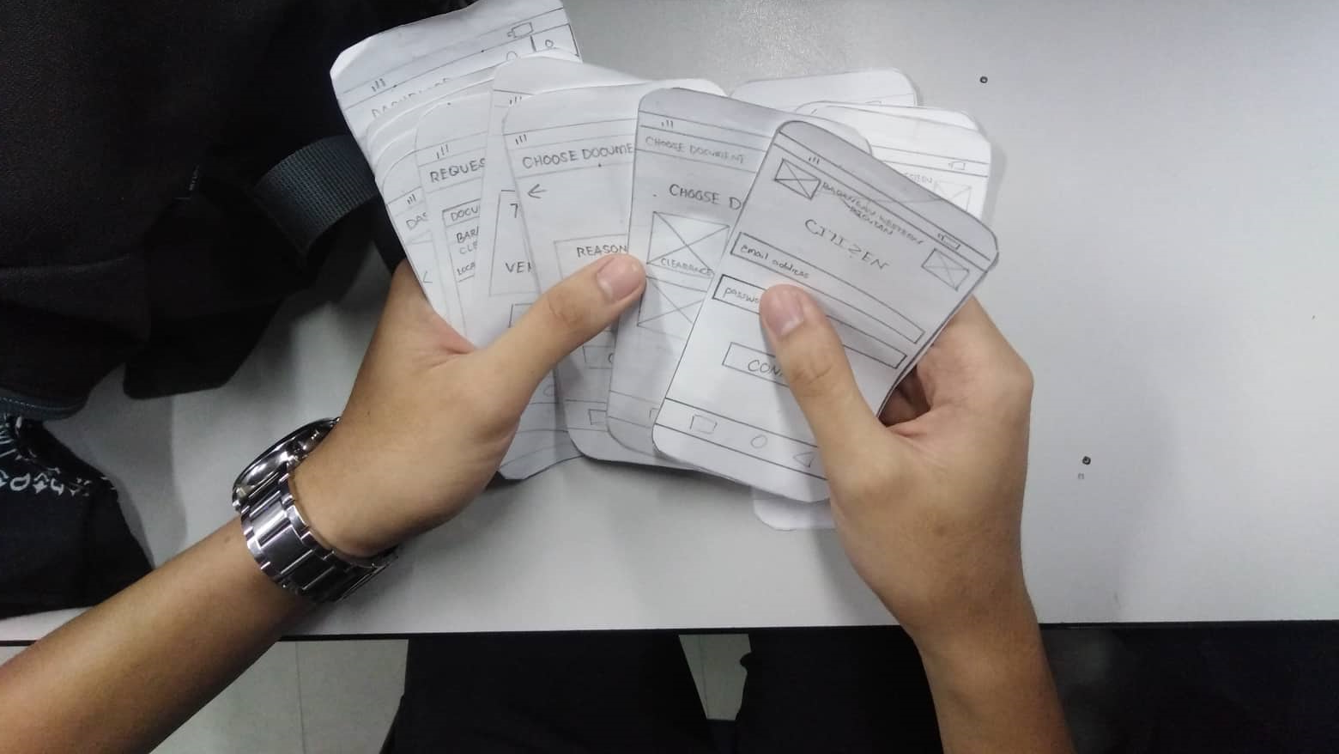

Slide 12
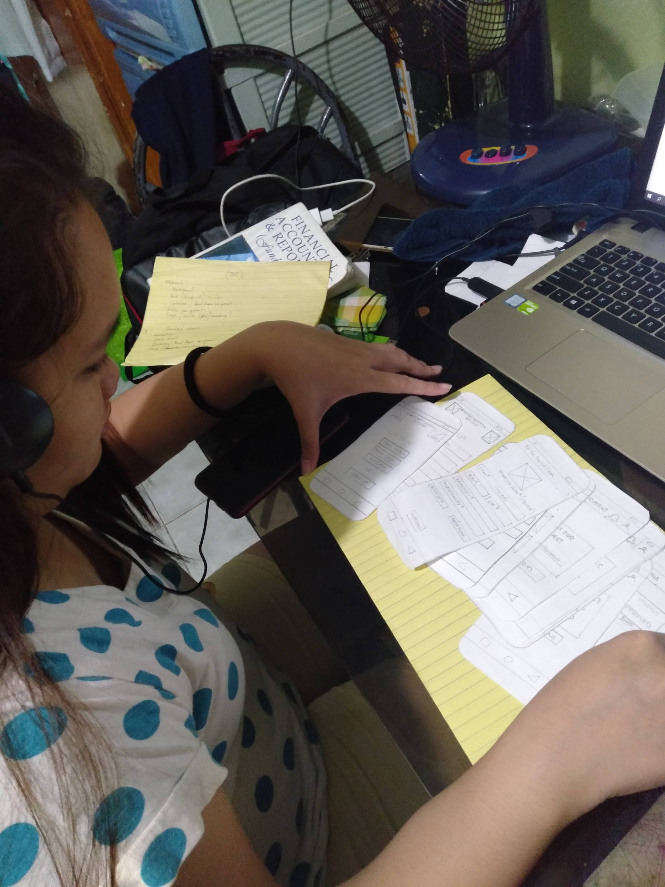
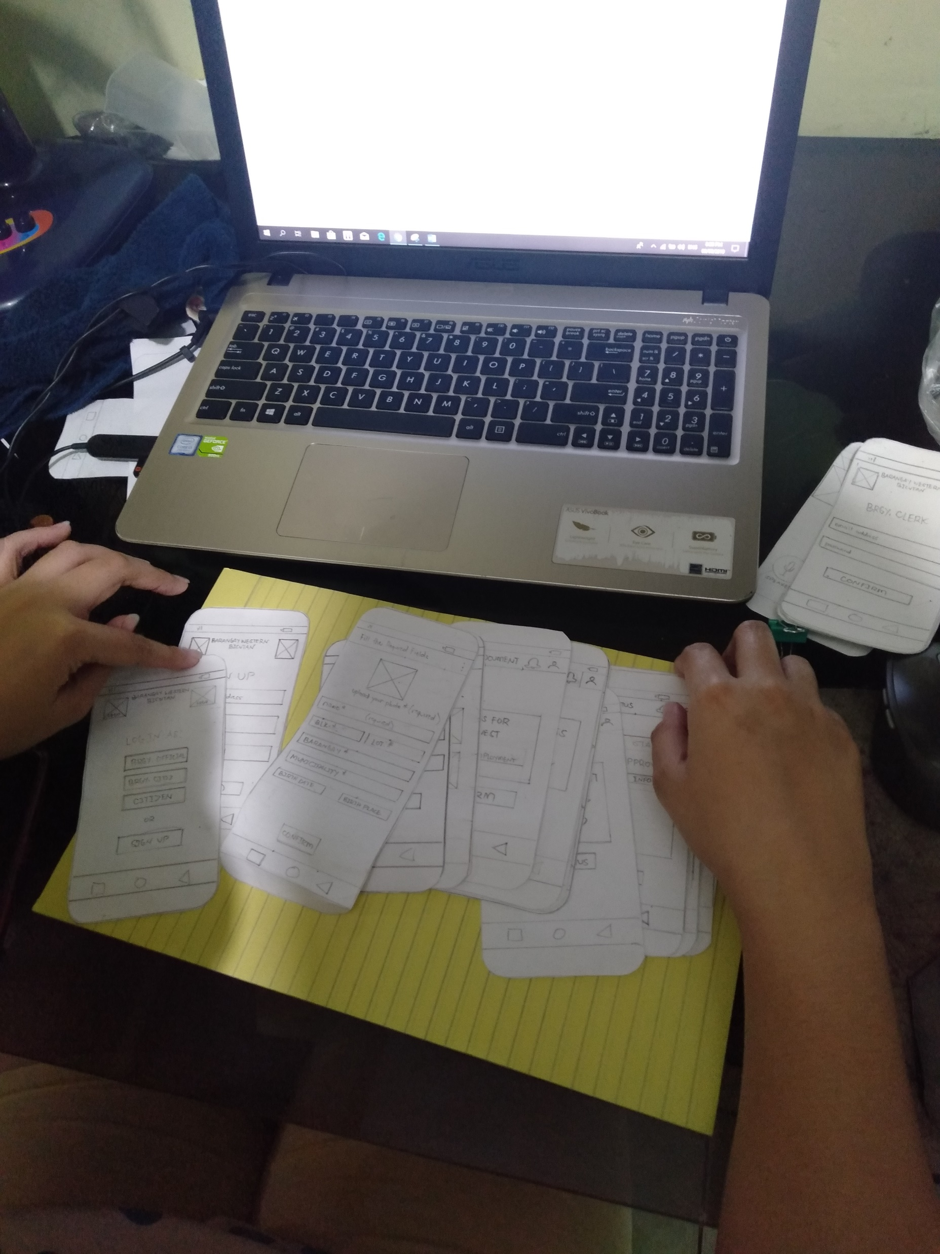

Slide 13
Comments, Feedbacks and Suggestions
“The application is super easy to navigate and understand”
“My recommendation is that the app must also feature a one tap login system, to lessen the time consumed when typing your username or email and password to sign in.”
“The app has instructions that is so easy to understand and learn.”
“The app is straight forward, and it can be easily navigate by everyone.”
“As an official, it will be helpful for us to know who are requesting documents and to communicate with them for verification and authorization.”

